Slide 1
Ticket handling using Java
By,
Santosh S Gumaste
Sama Rajeshwari
Pabboju Shivani
Kurva Usharani
June, 2023

Slide 2

DAY 1
.NET Platform​
.NET framework​
CLR​
Compilation and Execution​
C# & Compilation and EXE​
General Structure​
Creating and using DLL​

Slide 3
.NET is a comprehensive and flexible software framework developed by Microsoft, which provides a programming model, libraries, and runtime environment for building and running various types of applications, including web, desktop, mobile, and cloud-based applications.​
CLR (Common Language Runtime) is like the "engine" that runs .NET applications. It takes care of important tasks such as managing memory, handling errors, and running the code efficiently. ​

Slide 4
Compilation and Execution comprises of three stages Compilation in which our code is transformed into IL (Intermediate Language), JIT Compilation IL is transformed into machine language & Execution where CLR executes the machine code.​
C# is a programming language developed by Microsoft that is easy to learn and widely used for building a variety of applications. It is part of the .NET framework and offers a modern and object-oriented approach to programming.​
C# is as same as Java programming with some changes in the syntax and it acts as with vast inbuild libraries​

Slide 5
General Structure of C# program
Start
Using Directives
Namespace Declaration
Class Definition
Main Method
Statements and Expressions
Control Flow
Class Members
End

Slide 6
DAY 2
.NET Platform​
.NET framework​
CLR​
Compilation and Execution​
C# & Compilation and EXE​
General Structure​
Creating and using DLL

Slide 7
agenda
Problem Statement
SLA
Functional Requirements

Slide 8

Problem Statement
As a Tech Support Engineer, you are supporting the monitoring of the company’s infrastructure. Tracking of the performance and availability of the infrastructure is captured in the form of log data, available in a text/CSV file.

Slide 9
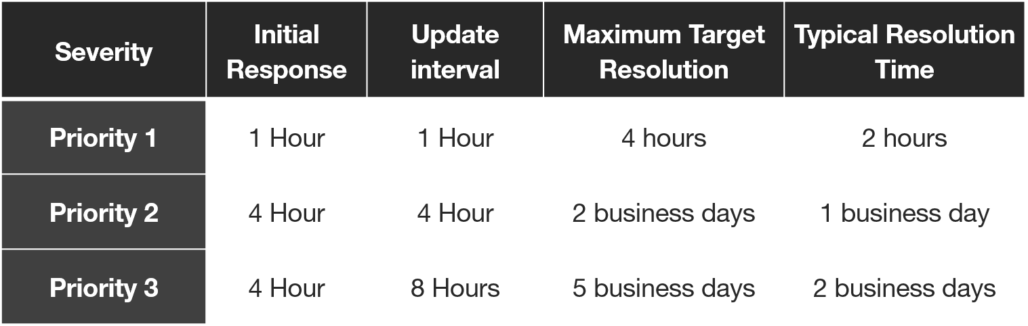
SLA
SLA – SERVICE LEVEL AGREEMENT
SLA response time - The time taken by provider to respond to an inquiry or request from a client

Slide 10

Functional Requirements
Based on the ticket type, identify the SLA time
Allocate every ticket to a Tech Support Engineer, via an e-mail notification with all the ticket details
At the end of processing all tickets, the detailed summary of the tickets should be sent to the line manager, via e-mail

Slide 11
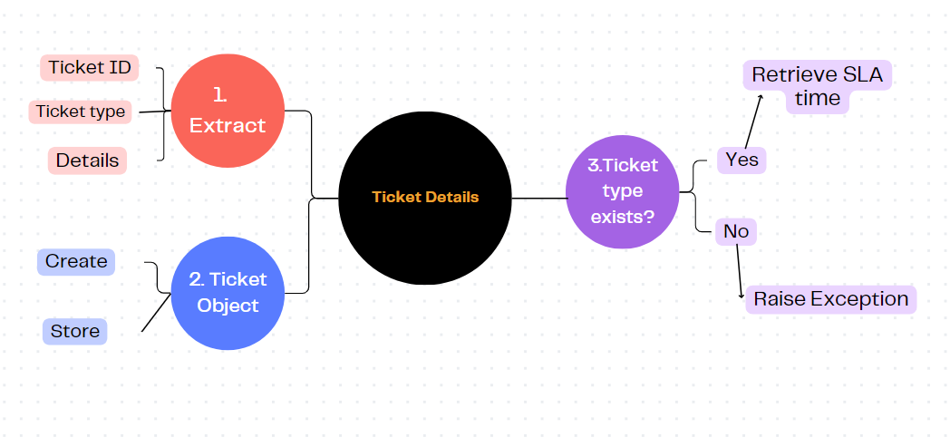
Functional Requirement 1: Based on the ticket type, identify the SLA time
.

Slide 12
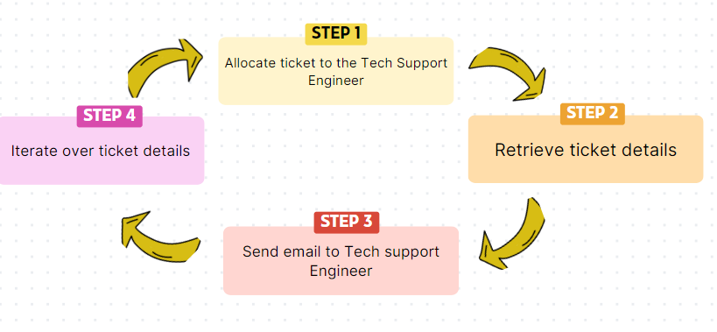
Functional Requirement 2: Allocate every ticket to a Tech Support Engineer, via an e-mail notification with all the ticket details

Slide 13
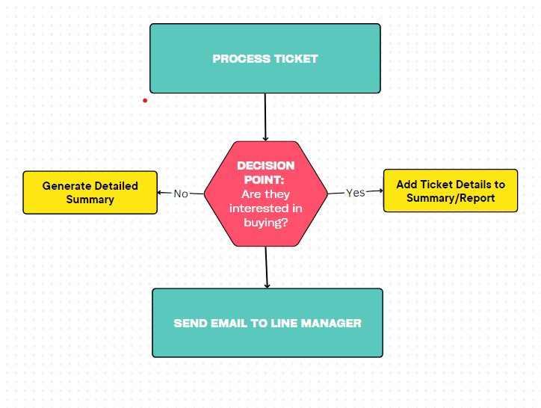
Functional Requirement 3: At the end of processing all tickets, the detailed summary of the tickets should be sent to the line manager, via e-mail

Slide 14
thank you
copyright publicis sapient | confidential

